Slide 1
Advanced Techniques about HTML (Tables & Forms)
CDS 4010

Slide 2
HTML Table
HTML tag <Table></Table> | Comments Table definition and end tag
<Caption> </Caption> | Caption definition and end tag
<TR> </TR> | Row definition and end tag
<TD> </TD> | Cell definition and end tag
W3Schools：www.w3schools.com

Slide 3
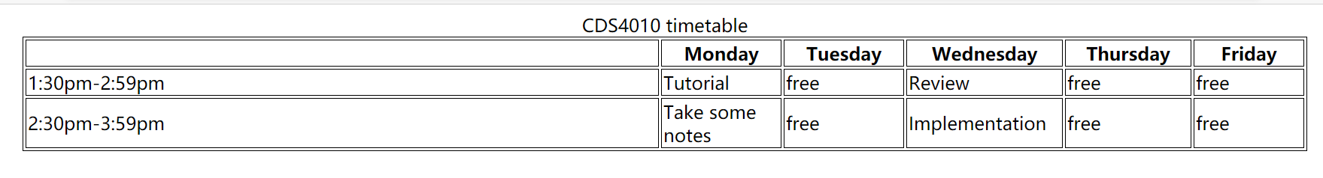
Table
<HTML>
<HEAD>
<TITLE>
HTML Table Design
</TITLE>
<style>
table, th, td {
border: 1px solid black;
}
</style>
</HEAD>
<BODY>
<TABLE style= "width: 80%" align = "center">
<caption> CSC4010 timetable </caption>
<tr >
<td width=50%> </td>
<th width = 150> Monday </th>
<th width = 150> Tuesday</th>
<th width = 150> Wednesday </th>
<th width = 150> Thursday</th>
<th width = 150> Friday</th>
</tr>
<tr >
<td > 1:30pm-2:59pm </td>
<td > Tutorial</td>
<td > free </td>
<td > Review </td>
<td > free </td>
<td > free </td>
</tr>
<tr >
<td > 2:30pm-3:59pm </td>
<td > Take some notes</td>
<td > free </td>
<td > Implementation </td>
<td > free </td>
<td > free </td>
</tr>
</TABLE>
</BODY >
</HTML >
‘td’ stands for ‘tabular data’ .
‘th’ stands for ‘tabular header’.

Slide 4
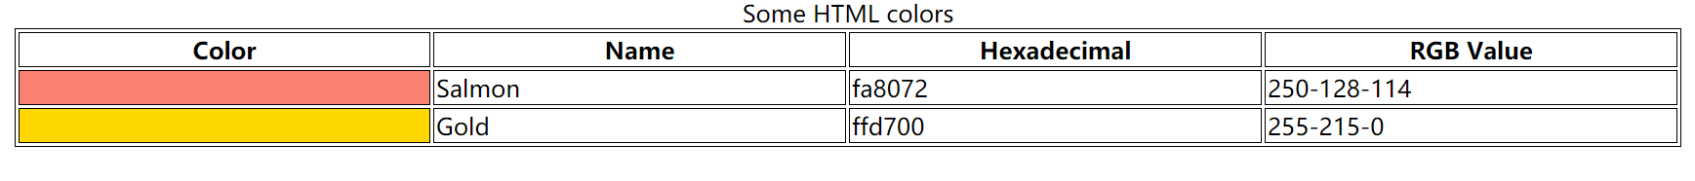
HTML Color Table
<HTML>
<HEAD>
<TITLE>
HTML Table Design
</TITLE>
<style>
table, th, td {
border: 1px solid black;
}
</style>
</HEAD>
<BODY>
<TABLE style= "width: 80%" align = "center">
<caption> Some HTML colors </caption>
<tr >
<th width = 150> Color</th>
<th width = 150> Name</th>
<th width = 150> Hexadecimal</th>
<th width = 150> RGB Value</th>
</tr>
<tr >
<td bgcolor = "fa8072"> </td>
<td > Salmon</td>
<td > fa8072 </td>
<td > 250-128-114 </td>
</tr>
<tr >
<td bgcolor = "ffd700"> </td>
<td > Gold</td>
<td > ffd700 </td>
<td > 255-215-0 </td>
</tr>
</TABLE>
</BODY >
</HTML >

Slide 5
Using Tables in Page Design
<TABLE style= "width: 30%" align = "center">
<tr >
<td bgcolor = "silver" height =100> silver cell</td>
</tr>
<tr >
<td bgcolor = "gold" height =100> gold cell</td>
</tr>
</TABLE>
<TABLE style= "width: 30%" align = "center">
<tr >
<td bgcolor = "red" rowspan = 2 width = 75> red cell</td>
<td bgcolor = "silver" height =100> silver cell</td>
</tr>
<tr >
<td bgcolor = "gold" height =100> gold cell</td>
</tr>
</TABLE>
insert a red cell spanning two rows.

Slide 6
Using Tables in Page Design
<TABLE style= "width: 30%" align = "center">
<tr >
<td bgcolor = "silver" height =100> silver cell</td>
</tr>
<tr >
<td bgcolor = "gold" height =100> gold cell</td>
</tr>
</TABLE>
<TABLE style= "width: 30%" align = "center">
<tr>
<td colspan=2 height=100 bgcolor="red">red cell</td>
</tr>
<tr >
<td bgcolor = "silver" height =100> silver cell</td>
<td bgcolor = "gold" height =100> gold cell</td>
</tr>
</TABLE>
insert a cell that spans the two columns

Slide 7
Using Tables in Page Design
<TABLE style= "width: 30%" align = "center" cellspadding = 15>
<tr>
<td colspan=2 height=100 bgcolor="red">red cell</td>
</tr>
<tr >
<td bgcolor = "silver" height =100> silver cell</td>
<td bgcolor = "gold" height =100> gold cell</td>
</tr>
</TABLE>
<TABLE style= "width: 30%" align = "center" cellspacing = 15>
<tr>
<td colspan=2 height=100 bgcolor="red">red cell</td>
</tr>
<tr >
<td bgcolor = "silver" height =100> silver cell</td>
<td bgcolor = "gold" height =100> gold cell</td>
</tr>
</TABLE>
<table cellpadding = x> where x is the thickness, measured in pixels.
It specifies the space between the border of a table cell and its contents.
<table cellspacing=x> x is the amount of cells pacing required.

Slide 8
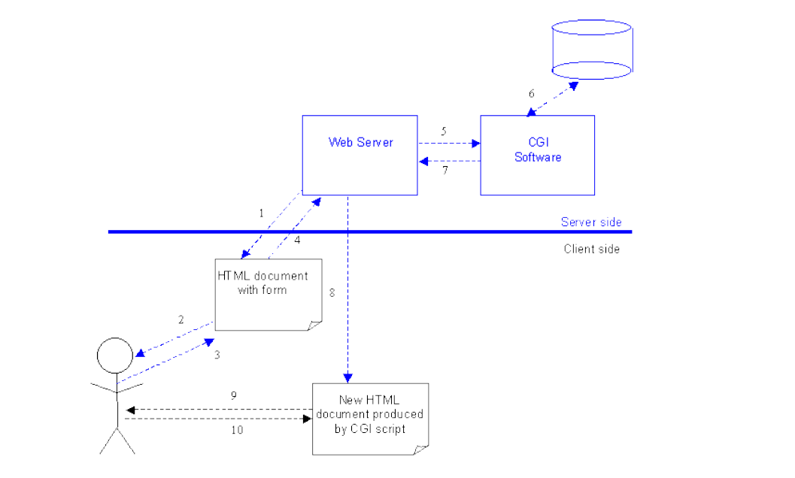
Forms
All forms start with the <FORM> tag and end with </FORM>.
The form tag has two main properties: METHOD and ACTION.
METHOD refers to post or get. The post attribute will send the information from the form as a text document.
The get attribute is used mostly with search engines, and will not be discussed. We will generally set METHOD="post".
ACTION usually specifies the location of the CGI script that will process the form data.
Notes:
Common Gateway Interface

Slide 9
Forms-Radio Buttons
Do you like chocolate?
<input type="radio" name="chocolate" value="yes">Yes
<input type="radio" name="chocolate" value="no">No
Do you agree that the Earth orbits the Sun?<br>
<INPUT TYPE="radio" NAME="orbits" VALUE="strongly_agree">Strongly agree<BR>
<INPUT TYPE="radio" NAME="orbits" VALUE="agree">Agree<BR>
<INPUT TYPE="radio" NAME="orbits" VALUE="no_opinion">No opinion<BR>
<INPUT TYPE="radio" NAME="orbits" VALUE="disagree">Disagree<BR>
<INPUT TYPE="radio" NAME="orbits" VALUE="strongly_disagree">Strongly
disagree<BR>
<input> is the tag used for most of the form objects.
type="radio" sets the object to a radio button.
name="orbits" labels the entire set of radio buttons. This makes identifying the data easier. This information is sent with the data when the form is submitted.

Slide 10
Forms-Check Box
<INPUT TYPE="checkbox" NAME="autos" VALUE="yes">Autos<BR>
<INPUT TYPE="checkbox" NAME="business"
VALUE="yes">Business & Finance<BR>
<INPUT TYPE="checkbox" NAME="movies"
VALUE="yes">Movies<BR>
<INPUT TYPE="checkbox" NAME="music" VALUE="yes">Music<BR>
<INPUT TYPE="checkbox" NAME="computing"
VALUE="yes">Computers & Internet<BR>
<INPUT TYPE="checkbox" NAME="science"
VALUE="yes">Science<BR>
<INPUT TYPE="checkbox" NAME="sports"
VALUE="yes">Sports<BR>
<INPUT> is the tag used for most of the form
objects. type="checkbox" sets the object to a
checkbox. name is used to supply a name to the
checkbox.
VALUE="yes" if the item is checked, this is the value that will be associated with the name when the form is submitted for processing. Hence, in the example, yes will be associated
with each of the name values movies, science and sports.

Slide 11
Forms - Submit and Reset Buttons
<FORM METHOD="post" ACTION="mailto:pizza-orders@medpizzas.com.eg">
<P>We only use fresh ingredients and some pizza toppings
may not be available. We will supply three from your list.</P>
Please list preferred toppings in order: <BR>
<TEXTAREA NAME="toppings" COLS="40" ROWS="5" WRAP=OFF></TEXTAREA><br>
Pizza size:<BR>
<INPUT TYPE="radio" NAME="pizza_size" VALUE="small">Small<BR>
<INPUT TYPE="radio" NAME="pizza_size" VALUE="medium" CHECKED>Medium<BR>
<INPUT TYPE="radio" NAME="pizza_size" VALUE="large">Large<BR>
<INPUT TYPE="submit" VALUE="Order the pizza">
<INPUT TYPE="reset" VALUE="Clear to restart">
</FORM>

Slide 12
Forms - Submit and Reset Buttons
<FORM METHOD="post" ACTION="mailto:pizza-orders@medpizzas.com.eg">
<P>We only use fresh ingredients and some pizza toppings
may not be available. We will supply three from your list.</P> Please
list preferred toppings in order:<BR>
<TEXTAREA NAME="toppings" COLS="40" ROWS="5" WRAP=OFF></TEXTAREA><br>
Pizza size:<BR>
<INPUT TYPE="radio" NAME="pizza_size" VALUE="small">Small<BR>
<INPUT TYPE="radio" NAME="pizza_size" VALUE="medium" CHECKED>Medium<BR>
<INPUT TYPE="radio" NAME="pizza_size" VALUE="large">Large<BR>
<INPUT TYPE="submit" VALUE="Order the pizza">
<INPUT TYPE="reset" VALUE="Clear to restart">
</FORM>

Slide 13
Forms
Address 1: <INPUT TYPE="text" NAME="address1" SIZE="40">
<BR>
Address 2: <INPUT TYPE="text" NAME="address2" SIZE="40">
<BR>
Address 3:<INPUT TYPE="text" NAME="address3" SIZE="40">
<BR>
Postcode: <INPUT TYPE="text" NAME="postcode" SIZE="20"><BR>

Slide 14
Forms
<TR>
<TDALIGN="right">What is your favourite World Wide Web site
and why?</TD>
<TD><TEXTAREA name="textfield4" cols="40" rows="4">give details
here</TEXTAREA></TD>
</TR>
<TR>
<TDALIGN="right">What is your favourite USENET discussion group
and why?</TD>
<TD><TEXTAREA name="textarea" cols="40" rows="4">give details
here</TEXTAREA></TD>
</TR>
<TR>
<TDALIGN="right">What it the best designed website you have
come across and why?</TD>
<TD><TEXTAREA name="textarea2" cols="40" rows="4">give details
here</TEXTAREA></TD>
</TR>

Slide 15
Forms – Drop-down Menu
<FORM METHOD="post" ACTION=mailto:name@xyz.ac.uk>
Title
<SELECT NAME="title">
<OPTION>Select title</OPTION>
<OPTION>Mr</OPTION>
<OPTION>Mrs</OPTION>
<OPTION>Miss</OPTION>
<OPTION>Ms</OPTION>
<OPTION>Dr</OPTION>
</SELECT><BR><BR>
Age:
<SELECT NAME="age">
<OPTION>Select Age</OPTION>
<OPTION>-19</OPTION>
<OPTION>20-29</OPTION>
<OPTION>30-39</OPTION>
<OPTION>40-49</OPTION>
<OPTION>50-59</OPTION>
<OPTION>60+</OPTION>
</SELECT><BR><BR>
Gender:
<SELECT NAME="gender">
<OPTION>Select Gender</OPTION>
<OPTION>Male</OPTION>
<OPTION>Female</OPTION>
</SELECT><BR><BR>
Status:
<SELECT NAME="status">
<OPTION>Select Status</OPTION>
<OPTION>Employed</OPTION>
<OPTION>Unemployed</OPTION>
<OPTION>Student</OPTION>
</SELECT><BR><BR>
</FORM>

